Slide 1
Rogerian Argument
Can’t we all just get along?

Slide 2
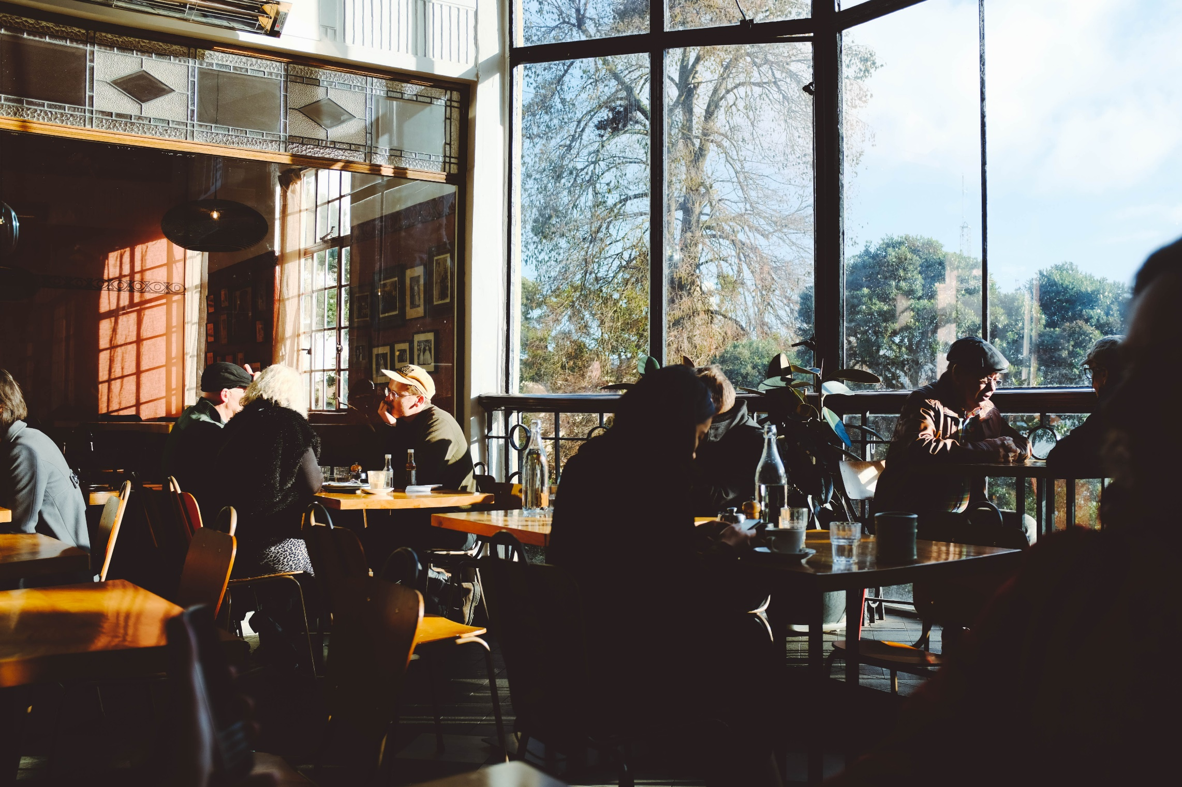
Objectives
Goals
Strategies
Value Conflicts
Examples and Practice

Slide 3
Goals

Slide 4
Rogerian Arguments
Therapist Carl Rogers
Reduce conflict between hostile parties
Empathetic Listening
Reduces the reader’s sense of threat
Notes:
“empathic listening” as the ability to see an issue sympathetically from another person’s perspective
Rogers said that with value-laden topics, you should truthfully listen then “say back” what you understand the other person to be saying

Slide 5
Goals
Increase empathy and respect
Demonstrate understanding
Recognize merit
Analyze experiences and values
Find common ground
Propose compromise
Continue dialogue

Slide 6
“Common Ground” USA Today
Bob Beckel Democratic Political Strategist
Cal Thomas Conservative Columnist

Slide 7
Strategies

Slide 8
Strategies for Rogerian
Show understanding of other side
Use cool emotions and describe the person’s position
Use explanatory analysis
Use process or cause/effect to discuss how/why their ideas work
Look for merit
Describe shared motives
Attitudes, experience, perception, goals that are similar

Slide 9
Strategies for Rogerian
Show the benefit of your position
How do your ideas compliment each other
What do you provide that they lack?
What do THEY provide that YOU lack?
Propose compromises
Use elements of both positions
You’re asking them to shift, not change
Show that you’ve shifted too
Use language that creates ethos
Notes:
“empathic listening” as the ability to see an issue sympathetically from another person’s perspective
Rogers said that with value-laden topics, you should truthfully listen then “say back” what you understand the other person to be saying

Slide 10
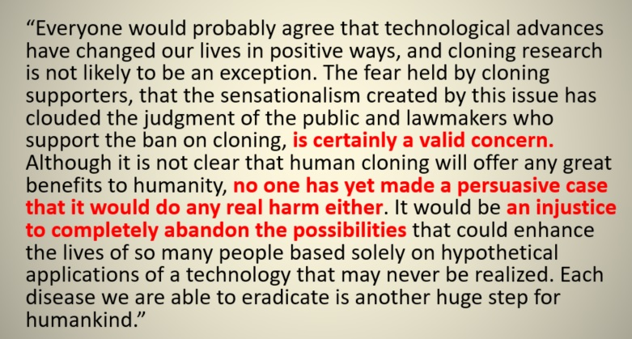
Student example
Show understanding
Analysis
Shared Motives
Benefits
Compromises
Language

Slide 11
Concession
Agreeing with the validity of some of the reader’s concerns or objections
Your position has weaknesses
Incorporate some of their concerns into your solution
Your position is still strong, but you’re willing to see their point
Give ground to get ground

Slide 12
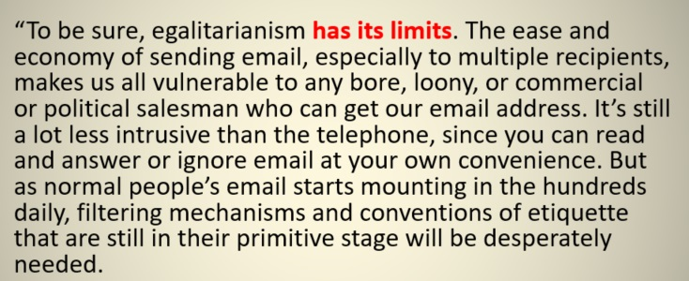
Professional example: Disadvantages of using email
How does Michael Kinsley appeal to audience concerns?
First: his position is on the benefits of email
What concerns does his audience probably have?

Slide 13
Qualifying Language
Avoid certainty
Always, never, all, none, the best, the worst, absolutely, etc
Qualifying acknowledges limits
Most, few, some, possibly, probably, may be, etc
Avoid emotional identifiers and how you describe people/their ideas
Terrorist vs. Freedom Fighter, Pro-life vs Anti-choice
Creates audience resistance

Slide 14
Value Concerns

Slide 15
What are values?
Beliefs about truth/nature that influence our positions on issues.
Criminals should be punished.
Life is hard so school should be too.
Doctors are one of the most important professions in a strong society.
Cause and Effect Relationship

Slide 16
Value Conflict Examples
Loyalty vs. Honesty:
Should you tell your parents about your sister’s drug habits?
Freedom of Press/Transparency vs. Natl Security/Order:
Is it wise to hold weekly presidential press conferences?
Equality vs. Individualism:
Are racial quotas for employment fair?
Security vs. Excitement:
Should you choose a dangerous profession?
Notes:
“empathic listening” as the ability to see an issue sympathetically from another person’s perspective
Rogers said that with value-laden topics, you should truthfully listen then “say back” what you understand the other person to be saying

Slide 17
Build Common Ground
Compare the following:
Both of your motives and priorities
Your and their assumptions
Your and their ideas and ideals
Your and their values, morals, ethics, religious principles, etc
Your and their fears and concerns
Your and their needs, interests, desires
What are each of you unwilling to give up?

